Slide 1
AZ-104T00A Administer Azure Virtual Machines

Slide 2
Administer Azure Virtual Machines Overview
Configure Virtual Machines
Configure Virtual Machine Availability
Lab 08 – Manage Virtual Machines
Notes:
These Learn modules are part of the AZ-104: Deploy and manage Azure compute resources (https://docs.microsoft.com/learn/paths/az-104-manage-compute-resources/) learning path.

Slide 3
Administer Virtual Machines whiteboard and review
Azure virtual machines
Storage
Name
Responsibilities
Image
Ubuntu
Windows
Red hat
SUSE
…..
Custom
Access
Bastion
RDP/SSH
Sizing/cost
General purpose
Compute optimized
Memory optimized
Storage optimized
GPU
HPC
Availability options
Availability zones
Availability sets
VM scale sets
Notes:
Optional whiteboard slide to introduce the module or review the content. Use the whiteboard diagram directly or recreate the image during the class. Focus this whiteboard on creating virtual machines.
Describe at least three things you would need to consider before creating an Azure virtual machine.
Answer: Locating the virtual machine in a region that is close to your users. Selecting the best virtual machine size for your application. Determining how cost will be determined and estimating the monthly cost. Deciding on disk storage including standard, premium, or ultra. Selecting an operating system and version. How you will monitor and update the virtual machine. If any additional scripts, configuration, or agents are required.
Describe ways connect and sign-in to a virtual machine.
Answer: Bastion is the recommended way to connect to a virtual machine. For example, to install required software. Bastion lets you access the virtual machine through the Azure portal over SSL. You can also directly connect to a Windows server with the Remoted Desktop Protocol. For Linux machines you can use Secure Shell Protocol (SSH).
What is the difference between virtual and horizontal scaling?
Answer: Vertical scaling (scale up and scale down) is the process of increasing or decreasing power to a single instance of a workload. For example, selecting a virtual machine with more memory or faster CPU performance. Horizontal scaling (scale out and scale in) is the process of increasing or decreasing the number of instances of a workload. For example, adding additional virtual machines as the workload increases. Vertical scaling is usually a manual process. Horizontal scaling is usually automated.
What is a virtual machine scale set and when would you want to deploy them?
Answer: Azure virtual machine scale sets let you create and manage a group of load-balanced VMs. Scale sets provide redundancy and improved performance, applications are typically distributed across multiple instances. Each instance is identical, no pre-provisioning is required. As demand goes up more VMs are added. As demand goes down instances are removed. Scaling can be manual, automated, or a combination of both. To control costs, you control the instance count.
What is a virtual machine extension and when would you use it?
Answer: Azure VM extensions are small applications that provide post-deployment configuration and automation tasks on Azure VMs. For example, if a virtual machine requires software installation, anti-virus protection, or to run a script inside of it, a VM extension can be used. Azure VM extensions can be run with the Azure CLI, PowerShell, Azure Resource Manager templates, and the Azure portal.

Slide 4
Configure Virtual Machines

Slide 5
Configure Virtual Machines Introduction
Review Cloud Services Responsibilities
Plan Virtual Machines
Determine Virtual Machine Sizing
Determine Virtual Machine Storage
Demonstration - Creating a VM in the Portal
Connect to Virtual Machines
Connect to Windows Virtual Machines
Connect to Linux Virtual Machines
Summary and Resources
Notes:
Deploy and manage Azure compute resources (20–25%)
Create and configure VMs
Create a VM
Manage images by using the Azure Compute Gallery
Configure Azure Disk Encryption
Move VMs from one resource group to another
Manage VM sizes
Add data disks
Configure VM network settings
Implement and manage virtual networking (15–20%)
Configure secure access to virtual networks
Implement Azure Bastion

Slide 6
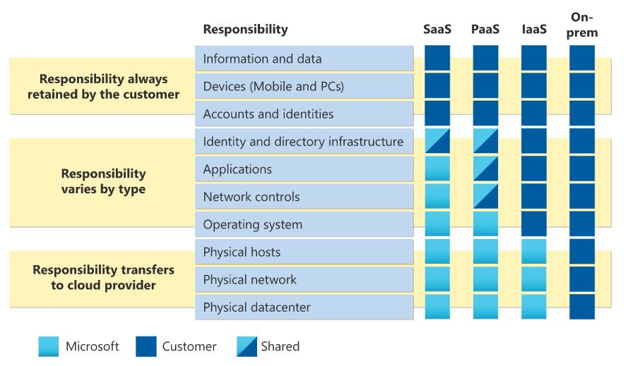
Review Cloud Services Responsibilities
Notes:
Test and development, website hosting, storage, backup, recovery, high-performance computing, big data analysis, and extended data center.
Graphic from: https://learn.microsoft.com/azure/security/fundamentals/shared-responsibility

Slide 7
Plan Virtual Machines
Start with the network
Name the virtual machine
Choose a location
Each region has different hardware and service capabilities
Locate Virtual Machines as close as possible to your users and to ensure compliance and legal obligations
Consider pricing
70+ Azure regions
Available in 140 countries
Notes:
Data residency - https://azure.microsoft.com/explore/global-infrastructure/data-residency/#select-geography

Slide 8
Determine Virtual Machine Sizing
Type | Description
General purpose | Balanced CPU-to-memory ratio.
Compute optimized | High CPU-to-memory ratio.
Memory optimized | High memory-to-CPU ratio.
Storage optimized | High disk throughput and I/O.
GPU | Specialized virtual machines targeted for heavy graphic rendering and video editing.
High performance compute | Our fastest and most powerful CPU virtual machines

Slide 9



Determine Virtual Machine Storage
Each Azure VM has two or more disks:
OS disk
Temporary disk (not all SKUs have one, content can be lost)
Data disks (optional)
Azure VM (Windows)
OS and data disks reside in Azure Storage accounts:
Azure-based storage service
Standard (HDD, SSD) or Premium (SSD), or Ultra (SSD)
C:\
OS disk
D:\
Temporary disk
F:\
Data disk
Azure VMs use managed disks
Azure blob
Notes:
Azure VM sizes with no temporary disks - https://learn.microsoft.com/azure/virtual-machines/azure-vms-no-temp-disk

Slide 10
Demonstration – Creating a VM in the Portal
Create the virtual machine
Connect to the virtual machine – Bastion, RDP, or SSH
Notes:
Quickstart - Create a Windows VM in the Azure portal - https://docs.microsoft.com/azure/virtual-machines/windows/quick-create-portal)
Quickstart - Create a Linux VM in the Azure portal - https://docs.microsoft.com/azure/virtual-machines/linux/quick-create-portal)
Connect to a virtual machine with Bastion - https://learn.microsoft.com/azure/bastion/tutorial-create-host-portal#connect

Slide 11
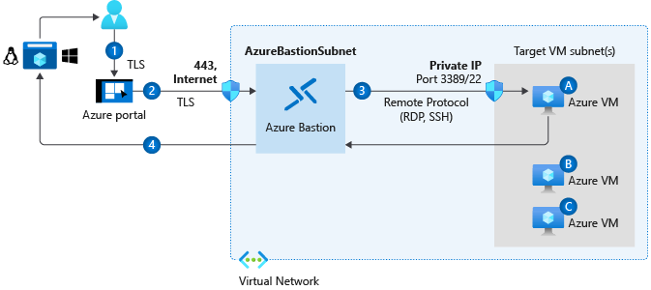
Connect to Virtual Machines
Bastion Subnet for RDP/SSH through the Portal over SSL
Remote Desktop Protocol for Windows-based Virtual Machines
Secure Shell Protocol for Linux based Virtual Machines

Slide 12
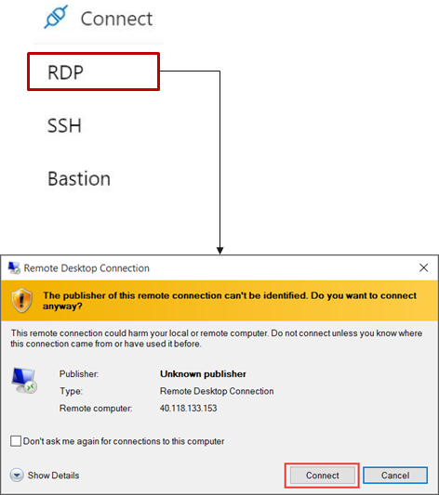
Connect to Windows Virtual Machines
Remote Desktop Protocol (RDP) creates a GUI session and accepts inbound traffic on TCP port 3389
WinRM creates a command-line session so you can run scripts

Slide 13
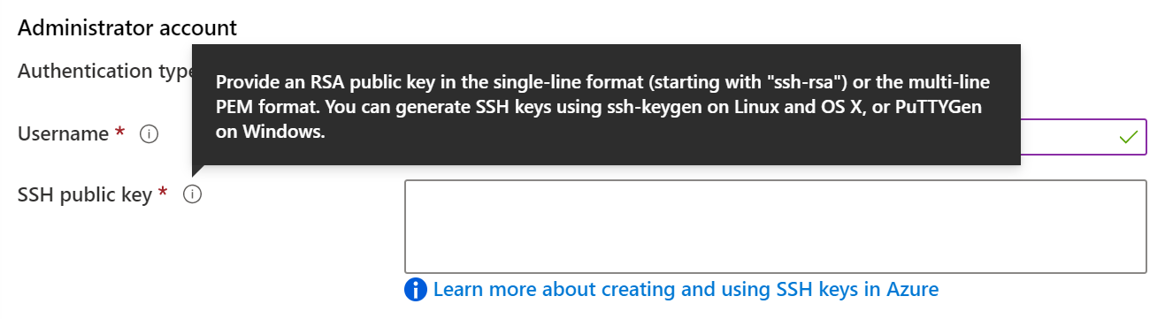
Connect to Linux Virtual Machines
Authenticate with a SSH public key or password
SSH is an encrypted connection protocol that allows secure logins over unsecured connections
There are public and private keys

Slide 14
Summary and Resources - Configure Virtual Machines
Knowledge Check Questions
Microsoft Learn Modules (docs.microsoft.com/Learn)
Introduction to Azure virtual machines (Sandbox)
Choose the right disk storage for your virtual machine workload
Create a Linux virtual machine in Azure (Sandbox)
Create a Windows virtual machine in Azure (Sandbox)
Connect to virtual machines through the Azure portal by using Azure Bastion
A sandbox indicates a hands-on exercise.

Slide 15
Configure Virtual Machine Availability

Slide 16
Configure Azure Virtual Machine Availability Introduction
Plan for Maintenance and Downtime
Setup Availability Sets
Review Update and Fault Domains
Review Availability Zones
Compare Vertical to Horizontal Scaling
Create Scale Sets (2 student topics)
Configure Autoscale (2 student topics)
Demonstration – Virtual Machine Scaling
Summary and Resources
Notes:
Deploy and manage Azure compute resources (20–25%)
Create and configure VMs
Configure VM availability options
Deploy and configure VM scale sets

Slide 17
Plan for Maintenance and Downtime
Unplanned Hardware Maintenance
Unexpected Downtime
Planned Maintenance
When the platform predicts a failure, it will issue an unplanned hardware maintenance event
Action: Live migration
Unexpected Downtime is when a virtual machine fails unexpectedly
Action: Automatically migrate (heal)
Planned Maintenance events are periodic updates made to the Azure platform
Action: No action

Slide 18
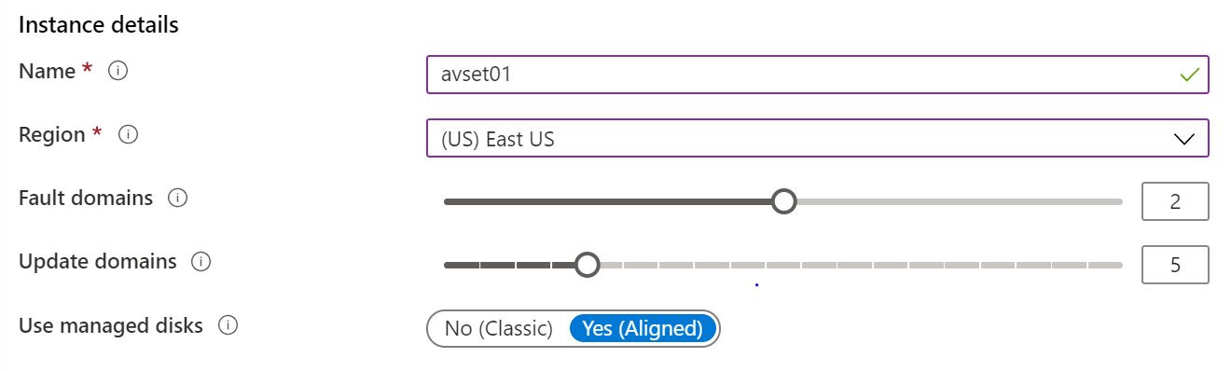
Setup Availability Sets
Two or more instances in Availability Sets = 99.95% SLA
Configure multiple Virtual Machines in an Availability Set
Configure each application tier into separate Availability Sets
Combine a Load Balancer with Availability Sets
Use managed disks with the Virtual Machines
Notes:
Availability set overview - https://learn.microsoft.com/azure/virtual-machines/availability-set-overview
Availability sets are about high availability.

Slide 19
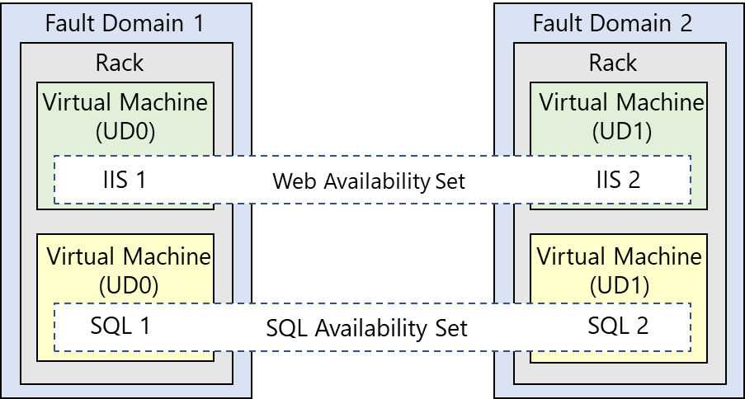
Review Update and Fault Domains
Update domains allows Azure to perform incremental or rolling upgrades across a deployment. During planned maintenance, only one update domain is rebooted at a time
Fault Domains are a group of Virtual Machines that share a common set of hardware, switches, that share a single point of failure. VMs in an availability set are placed in at least two fault domains
Notes:
Fault domain
Prevent Hardware failures like limit the impact of potential physical hardware failures, network outages, or power interruptions
1 Rack that share common power source and network switch.
Max- 3 FD per availability set, Default value=2
Update domain
Max= 20 UD, Default=5
Update domains indicate groups of virtual machines and underlying physical hardware that can be rebooted at the same time
The order of update domains being rebooted may not proceed sequentially during planned maintenance, but only one update domain is rebooted at a time. A rebooted update domain is given 30 minutes to recover before maintenance is initiated on a different update domain.

Slide 20
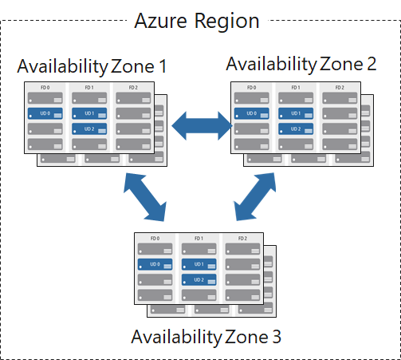
Review Availability Zones
Unique physical locations in a region
Includes datacenters with independent power, cooling, and networking
Protects from datacenter failures
Combines update and fault domains
Provides 99.99% SLA​

Slide 21
Compare Vertical to Horizontal Scaling
Vertical scaling (scale up and scale down) is the process of increasing or decreasing power to a single instance of a workload; usually manual​
Horizontal scaling (scale out and scale in) is the process of increasing or decreasing the number of instances of a workload; frequently automated

Slide 22
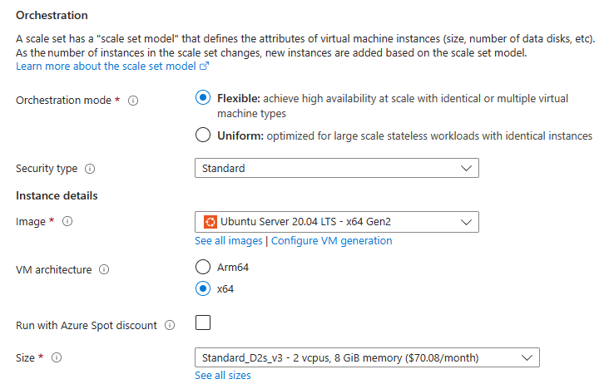
Create Scale Sets
Instance count. Number of VMs in the scale set (0 to 1000)
Instance size. The size of each virtual machine in the scale set
Azure Spot Instance. Unused capacity at a discounted rate
Use managed disks
Enable scaling beyond 100 instances
Notes:
What are virtual machine scale sets - https://learn.microsoft.com/azure/virtual-machine-scale-sets/overview
VMSS are all about performance.

Slide 23
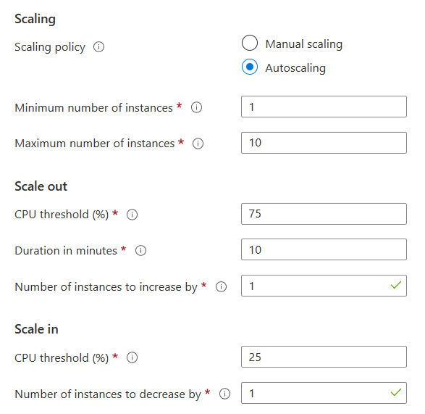
Configure Autoscale
Define a minimum, maximum, and default number of VM instances
Create more advanced scale sets with scale out and scale in parameters
Notes:
Autoscale - https://learn.microsoft.com/azure/virtual-machine-scale-sets/virtual-machine-scale-sets-autoscale-overview

Slide 24


Demonstration – Virtual Machine Scaling
Configure Virtual Machine Scale Sets
Review manual scaling, scale-in policies, and custom scaling options
Notes:
Create virtual machines in a scale set using Azure portal - https://learn.microsoft.com/azure/virtual-machine-scale-sets/flexible-virtual-machine-scale-sets-portal

Slide 25
Summary and Resources – Configure Virtual Machine Availability
Knowledge Check Questions
Microsoft Learn Modules (docs.microsoft.com/Learn)
Build a scalable application with virtual machine scale sets
Implement scale and high availability with Windows Server VM

Slide 26
Lab – Manage Virtual Machines

Slide 27
Lab 08 – Manage Virtual Machines
Lab scenario
You are tasked with identifying different options for deploying and configuring Azure Virtual Machines
Objectives
Task 1: Deploy zone-resilient Virtual Machines in the Azure portal and with templates
Task 2: Configure Azure Virtual Machines by using virtual machine extensions
Task 3: Scale compute and storage for Azure Virtual Machines
Task 4: Deploy zone-resilient scale sets by using the Azure portal
Task 5: Configure Azure virtual machine scale sets by using extensions
Task 6: Scale compute and storage for Azure virtual machine scale sets
Next slide for an architecture diagram

Slide 28









Lab 08 – Architecture diagram
Task 1
Task 2
Task 3, Task 4, Task 5, Task 6, Task 7
az104-08-rg01
az104-08-rg02
az104-06-vnet01 10.80.0.0/20
az104-08-rg02-vnet 10.82.0.0/20
Subnet0 10.80.0.0/24
Subnet0 10.82.0.0/24
az10408rg01diag938
az104-08-vm0
10.80.0.4
az104-08-vm1
10.80.0.5
az10408vmss0
az10408vmss0-lb
Zone1
Zone2
scripts
az10408vmss0-nsg
az10408vmss0-ip
az104-08-install_IIS.ps1

Slide 29

End of presentation

Slide 30
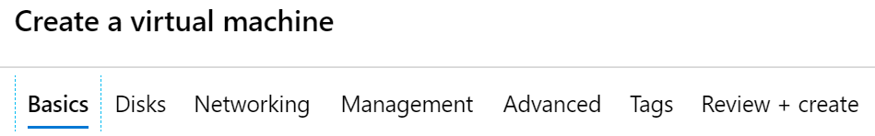
Create Virtual Machines in the Portal
Basic (required) – Project details, Administrator account, Inbound port rules
Disks – OS disk type, data disks
Networking – Virtual networks, load balancing
Management – Monitoring, Auto-shutdown, Backup
Advanced – Add additional configuration, agents, scripts or applications

Slide 31
Configure Virtual Machine Extensions

Slide 32
Configure Virtual Machine Extensions Introduction
Implement Virtual Machine Extensions
Implement Custom Script Extensions
Implement Desired State Configuration
Demonstration – Custom Script Extension (optional)
Summary and Resources
Notes:
Deploy and manage Azure compute resources (20–25%)
Automate deployment of resources by using templates
Deploy virtual machine (VM) extensions

Slide 33
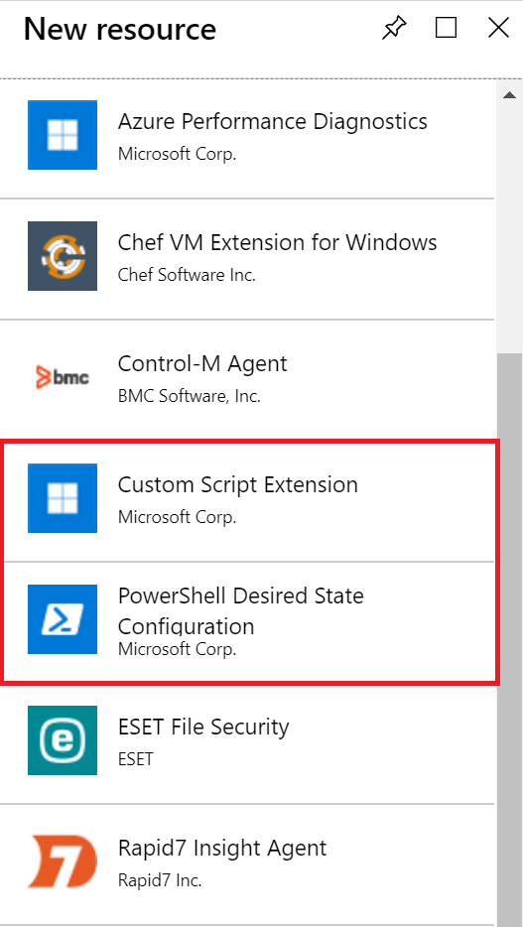
Implement Virtual Machine Extensions
Extensions are small applications that provide post-deployment VM configuration and automation tasks
Managed with Azure CLI, PowerShell, Azure Resource Manager templates, and the Azure portal
Bundled with a new VM deployment or run against any existing system
Different for Windows and Linux machines

Slide 34
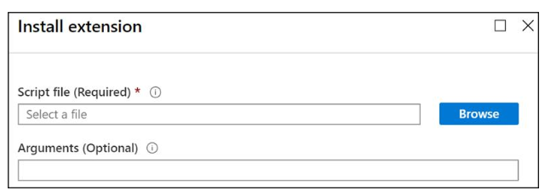
Implement Custom Script Extensions
Extension scripts can be simple or complex
Extensions have 90 minutes to run
Double check dependencies to ensure availability
Account for any errors that might occur
Protect/encrypt sensitive information

Slide 35
Implement Desired State Configuration
configuration IISInstall
{
Node “localhost”
{
WindowsFeature IIS
{
Ensure = “Present”
Name = “Web-Server”
}
}
}
Configuration block(s) have a name
Node blocks define the computers or VMs that you are configuring
Resource block(s) configure the resource and its properties
There are many built-in configuration resources

Slide 36
Demonstration – Custom Script Extension
Verify the Web Server feature is available on a virtual machine
Create a PowerShell script file to install the Web Server
Configure an Extension in the Portal to run the script
Verify the Web Server feature was installed

Slide 37
Summary and Resources - Configure Virtual Machine Extensions
Knowledge Check Questions
Microsoft Learn Modules (docs.microsoft.com/Learn)
Automate the configuration of Windows Server IaaS Virtual Machines
Protect your virtual machine settings with Azure Automation State Configuration (Sandbox)
A sandbox indicates a hands-on exercise.

Slide 38
Demonstration – Connect to Linux VMs (optional)
Create the SSH keys
Create the Linux machine and assign the public SSH key
Access the server using SSH

